Slide 1

Engineering Mathematics-I
Unit-I
Differential Calculus
Faculty of Mathematics
SNIST

Slide 2
UNIT-I
Differential Calculus:
Part-1: Single variable functions.
Rolle’s Theorem,
Lagrange’s mean value theorems
Cauchy mean value theorems,
Taylor’s series,
Maclaurin’s series

Slide 3
Part-2:
Functions of several variables:
Limit and Continuity of a function of two variables
Euler’s theorem
Total differentiation
Jacobian and its properties
Maxima and minima

Slide 4
Rolle’s Theorem Statement :
Let f(x) be continuous on [a,b] and differentiable on (a,b) such that f(a)=f(b).
Then there exist c∈(a,b) such that

Slide 5
Geometrical Interpretation:
y
y
f ′ (c) = 0
y = f(x)
f(a) = f(b)
y = f(x)
x
x
a
c
b
a
c₁
c₂
c₃
b
Figure-1
Figure-2

Slide 6
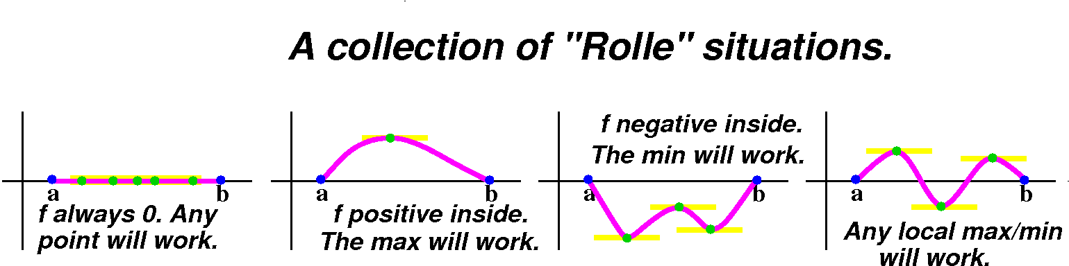

Slide 7
Note:
1. A polynomial function is every where continuous and differentiable.
2. The exponential function, sine and cosine functions are every where continuous and differentiable.

Slide 8
3.The sum, difference and product of continuous(differentiable) functions is continuous(differentiable).
4. tan(x) is not continuous at

Slide 9
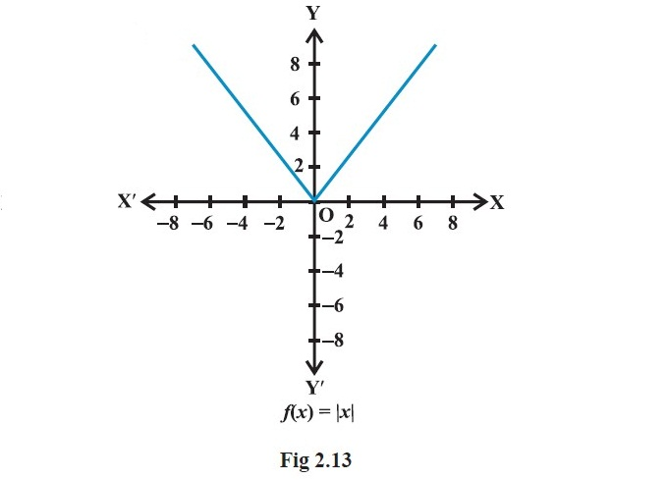
5. is not differentiable at

Slide 10
6. If
then
is not differentiable
at
Example:

Slide 11
Verification of Rolle’s Theorem:
Problem-1: Verify Rolle’s Theorem for the function
Solution:
Since the given function is a polynomial in ‘x’, it is continuous and differentiable on R.

Slide 12
Obviously it is continuous on [2,3]. and differentiable on (2,3).

Slide 13
All the conditions of Rolle’s theorem are satisfied.
Now by Rolle’s theorem,

Slide 14
Hence the Rolle’s theorem is verified.

Slide 15
Problem-2: Verify Rolle’s Theorem for the function
Solution:
Since are continuous and differentiable on R. The product
of these 3 functions is also continuous and differentiable on R.

Slide 16
Clearly it is continuous on [-3,0]. and differentiable on (-3,0). Now
Now by Rolle’s theorem,

Slide 19
Since
Hence the Rolle’s theorem is verified.

Slide 20
Problem-3: Discuss the applicability of Rolle’s Theorem for the function
Solution:
Here

Slide 21
Clearly,
does not exist at
Hence the Rolle’s theorem is not applicable for verification due to the function is not differentiable at x=2.

Slide 22
Lagrange’s Mean Value Theorem
Statement:
If f is continuous on [a,b] and
differentiable on (a,b) then
There exist at least one element c∈(a,b)
at which

Slide 23
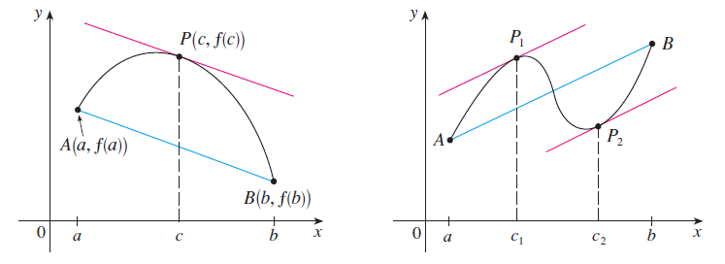
Geometrical Interpretation:
Conclusion: Slope of the line joining AB is Equals to Slope of tangent Line at P.

Slide 24
Verification of Lagrange’s Mean Value Theorem:
Problem-1: Verify Lagrange’s Mean Value Theorem for the function
Solution:
Here
is continuous and differentiable on
and
(-2,2)
respectively.

Slide 25
Here the given function satisfies conditions of Lagrange’s Mean Value Theorem.
Now

Slide 26
Since

Slide 27
Problem-2:
Verify Lagrange’s Mean
Value Theorem for the function
Solution:
is not differentiable at x=0. Hence LMVT is not applicable.

Slide 28
Problem-3: Show that the function
is monotonically increasing when
and is monotonically decreasing
when
Solution:
Since the given function is a polynomial in ‘x’, it is continuous and differentiable on R.

Slide 29
Now
Hence f(x) is monotonically increasing when
so f(x) is monotonically decreasing when

Slide 30
Problem-4:

Slide 31
Solution:
Let
It is continuous on [a,b] and
is differentiable on (a,b) [i.e. (0,1)]

Slide 32
Now by Lagrange's mean value theorem, we have

Slide 33
Since

Slide 35
From (1) and (2), we have

Slide 36
Now put b=3/5 and a=1/2 in equation(3) , we get

Slide 37
Adding
we get

Slide 38
Cauchy Mean Value Theorem
Statement:

Slide 40
Remark:
The Lagrange’s theorem is the special case of Cauchy’s theorem, whenever taking g(x)=x.
Geometrical Interpretation:
There is a point c∈(a,b), where the ratio of the gradients of two differentiable curves is same as the ratio of the gradients of the chords.

Slide 41
Verification of Cauchy Mean Value Theorem:
Problem-1: Verify Cauchy Mean Value Theorem for the function
Solution:
Let

Slide 42
Both are algebraic functions, so they are continuous on [1,4] and differentiable on (1,4).
Here the functions f(x) and g(x) satisfies conditions of Cauchy Mean Value Theorem.

Slide 43
Therefore
Hence the theorem is verified.

Slide 44
Problem-2: Using an appropriate mean value theorem, prove that
Hence deduce that

Slide 45
Solution:
Let
Since Sinx and are continuous and differentiable every where, so they are continuous on [a,b] and differentiable on (a,b).

Slide 46
Hence functions f(x) and g(x) satisfies all the conditions of Cauchy Mean Value Theorem.
Therefore

Slide 47
Deduction:
Putting b=x, a=0 in the above equation, we get

Slide 48
Problem-3:
Solution:
Let

Slide 49
log(1+x) and are continuous on [0,1].
These two derivatives are exist for all x∈(0,1).
Hence f(x) and g(x) are differentiable
on (0,1).

Slide 50
Thus, functions f(x) and g(x) satisfies all the conditions of Cauchy Mean Value Theorem.
Therefore

Slide 51
Since 0<c<x<1,

Slide 52
and
Hence,

Slide 53
From(1)&(2), we get

Slide 54
Introduction:
In many applications, we need to approximate a continuous function by a polynomial function.
Taylor’s theorem provides such an approximation for real functions.

Slide 55
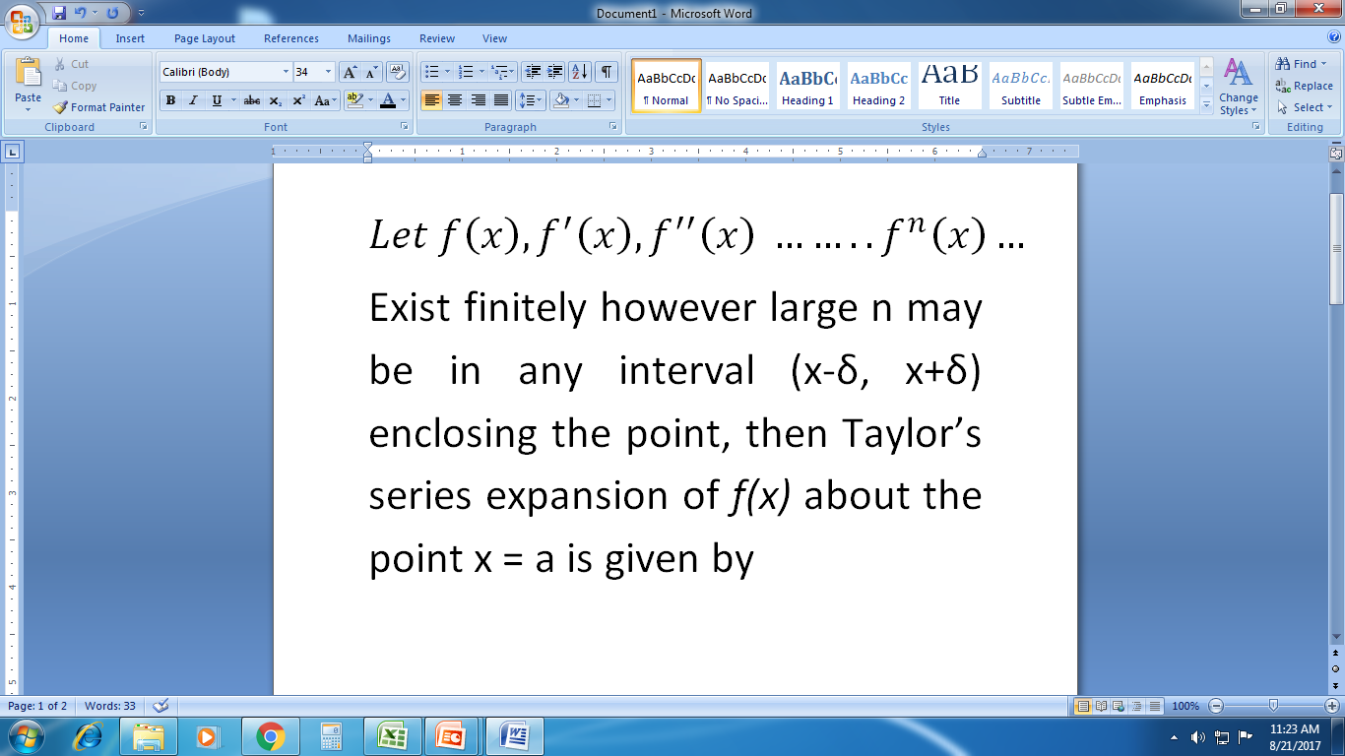
Taylor’s Series:

Slide 56
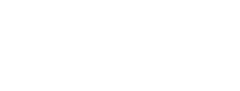

Slide 57
Maclaurin’s Series:
Taylor’s Series expansion of f(x) about the origin
i.e. x = 0 is said to be Maclaurin’s series.
And is given by

Slide 59
Problem-1:
Use Taylor’s Theorem to express the polynomial
in powers of (x-2).
Solution:
Let
To express the function f(x) as f(a+h),

Slide 60
Put a=2 and h=x-2, for to express the given polynomial in powers of (x-2)
Now by Taylor’s theorem,

Slide 61
Here
We have to find the derivatives of f(x) at x=2.

Slide 63
and all other higher order derivatives are zero.
Substituting these values in the above, we get

Slide 64
The above is the polynomial function f(x) in powers of (x-2).

Slide 65
Problem-2: Using Maclaurin series, find the expansion of a function
Solution:
Let
From Maclaurin’s series, we have

Slide 66
Put x=0, in eqn.(1)then we have
Differentiate eqn.(1),we get

Slide 67
The second derivative of f(x) is,

Slide 68
The third derivative of f(x) is,

Slide 69
The fourth derivative of f(x) is,

Slide 70
Substituting these values in Maclaurin series, we get

Slide 71
Approximation of Definite Integrals
Taylor’s polynomials are used to approximate functions on a given interval and since polynomials are easy to integrate, we can use Taylor’s polynomials to obtain an approximation of definite integrals.

Slide 72
Example: Use a Taylor’s series with
n=8 to approximate
Solution: We know that the Taylor’s series expansion of Cos(x) at x=0 is

Slide 73
which converges on all of (-∞,∞).
Now replacing ‘x’ by ‘x^{2’} gives us,

Slide 74
By considering first three terms of the above expansion (2), this leads us to the approximation

Slide 76
Conclusion:
The roots of the given function as well as equality or inequality of any two or more than two functions can be determined using mean value theorems.

